Slide 1
Neural Network and Perceptron

Slide 2
What is a Neural Network?
A Neural Network is a machine learning model inspired by the human brain.
• Consists of neurons (nodes) connected with weights
• Organized into layers: Input, Hidden, Output

Slide 3
Structure of Neural Network
Three main layers:
• Input Layer – Receives features
• Hidden Layer(s) – Performs computation
• Output Layer – Produces final result

Slide 4
Mathematical Model of a Neuron
Each neuron computes:
z = w1x1 + w2x2 + ... + wnxn + b
Output = f(z)
• w = weights, b = bias
• f(z) = activation function

Slide 5
What is a Perceptron?
Introduced by Frank Rosenblatt (1958)
• Simplest type of neural network
• Single layer binary classifier
• Uses step activation function

Slide 6
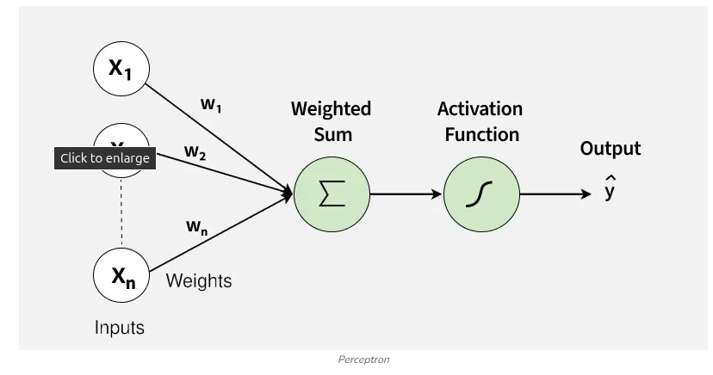

Slide 7
1. Inputs (x1,x2,...,xn)(x1​,x2​,...,xn​)
These are the features or measurable attributes of a data point that the perceptron uses to make a decision. Each input provides a signal that contributes to the final output.
2. Weights (w1,w2,...,wn)(w1​,w2​,...,wn​)
Weights determine how strongly each input contributes to the prediction. A larger weight means the corresponding input has a higher impact.
Weights are learned during training, adjusting based on errors.
They act like importance scores for each feature.

Slide 8
3. Bias
The bias is a constant value added to the weighted sum to shift the decision boundary.
It allows the perceptron to classify correctly even when all input features are zero.
Bias ensures the model is not forced to pass the decision boundary through the origin.
Difference Between Weights and Bias
Weights control how much each input influences the output.
Bias controls when the perceptron activates, independent of any input.

Slide 9


4. Net Input (Weighted Sum)
This is the combined effect of all inputs and their weights:
Represents the activation strength before passing through the activation function.
If z is high or low enough, it determines the final class.
5. Activation Function (Step / Threshold Function)
The activation function converts the numerical input into a binary output:
θ = threshold value.
Output is always 0 or 1 making perceptrons suitable for binary classification.

Slide 10
Perceptron Algorithm(simple)
Set a threshold value
Multiply all inputs with its weights
Sum all the results
Activate the output

Slide 11
How Perceptron Works
Steps:
• Multiply inputs with weights
• Add bias
• Apply step activation function
Output = 1 if wx + b > 0 else 0

Slide 12
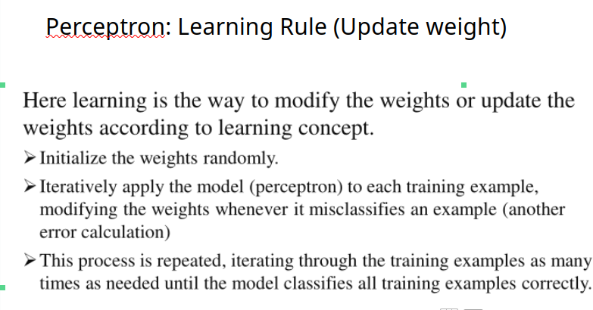
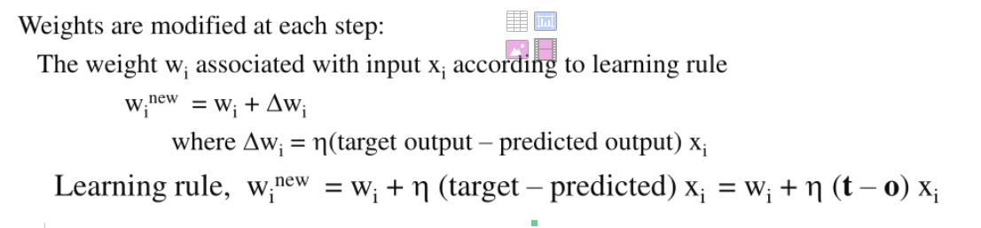

Slide 13
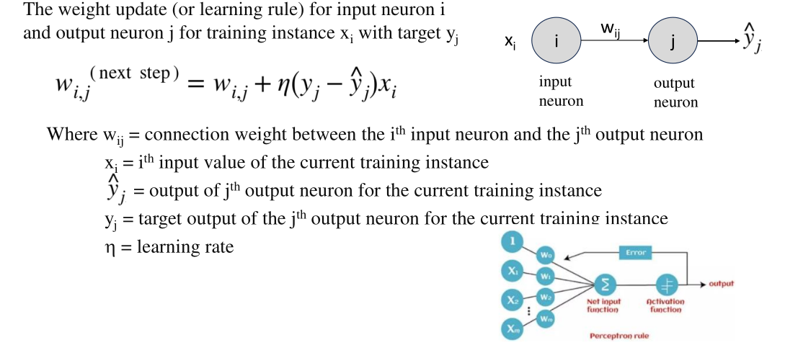

Slide 14
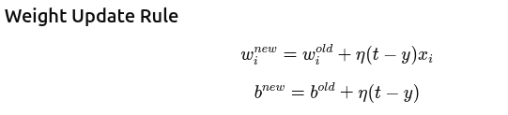

Slide 15
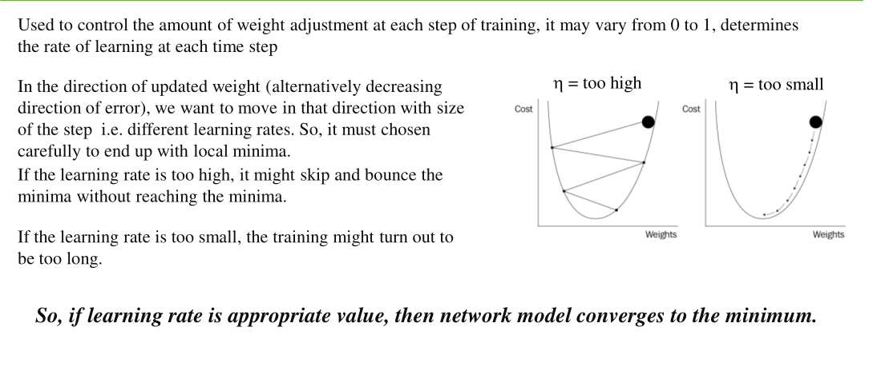
Learning rate

Slide 16
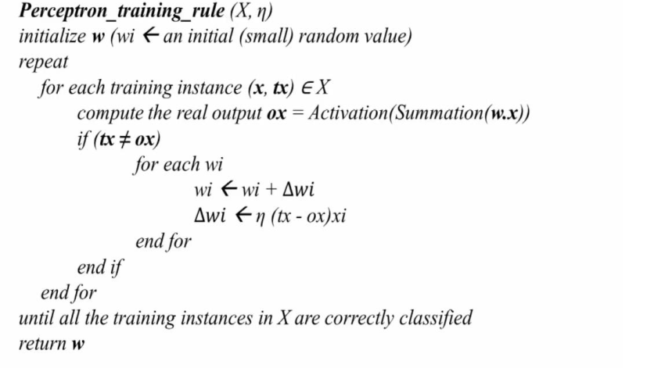
Perceptron Algorithm (with weight update)

Slide 17
Single Layer Perceptron (SLP)
• Only input and output layer
• Solves linearly separable problems
• Example: AND, OR gates
• Cannot solve XOR problem

Slide 18
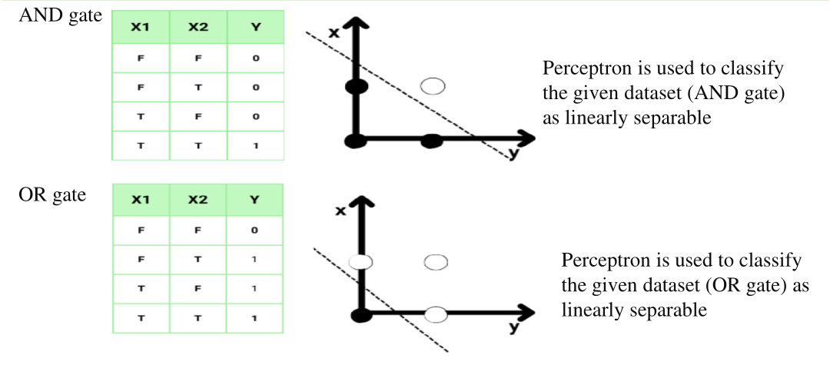

Slide 19
Advantages of Single Layer Perceptron
Simplicity and Efficiency: As the simplest form of Artificial Neural Network (ANN), they are easy to design, implement, and train.
Low Computational Cost: They require minimal hardware resources and can operate without specialized, high-end processors, making them ideal for lightweight applications.
Fast Training Time: With only one layer of weights to adjust, training is significantly faster compared to multi-layer networks.
Effective for Linearly Separable Data: They are highly effective at finding a linear decision boundary (hyperplane) to separate data into two classes.
Interpretability: Because they have fewer parameters, it is easier to understand how the model reaches a decision based on the weights assigned to inputs.

Slide 20
Limitations-Single Layer Perceptron
Inability to Solve Non-Linear Problems: A single-layer perceptron can only draw a single straight line (hyperplane) to separate classes. If data points are not linearly separable (e.g., XOR), the model fails to converge to a solution, regardless of training time.
Limited to Binary Classification: They are generally designed to output a binary result (0 or 1) using a hard-limit transfer function, making them unsuitable for multi-class classification or regression tasks.
Sensitivity to Initial Conditions: Performance is highly dependent on the initial weight configuration; poor initialization can lead to suboptimal or diverging solutions.

